Slide 1
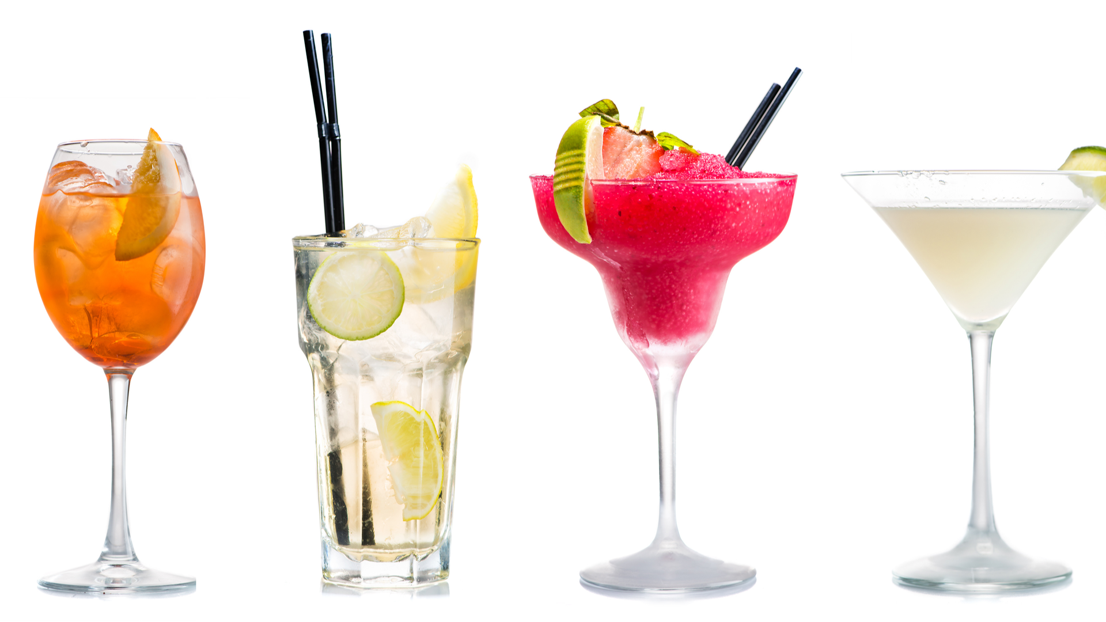
Data Pipelines Project
Gemma Draper

Slide 2
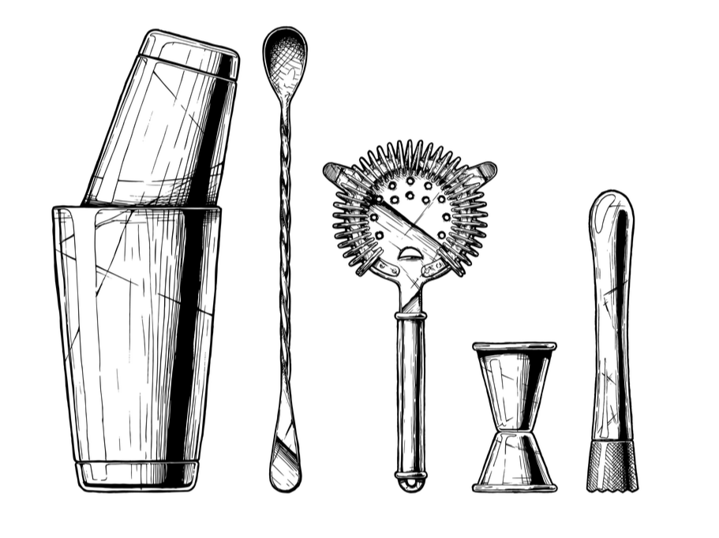
Project Hawthorne
Go to recipe sites
Collect recipes
Build large and varied dataset
Train ML model
AI-created cocktails!

Slide 3
The Plan
Go to:
allrecipes.co.uk
bbcgoodfood.com
tipsybartender.com
food52.com
drinksmixer.com
Get:
Name
Description
Ingredients
Method
etc...

Slide 4
Progress So Far...
Been to:
allrecipes.co.uk
bbcgoodfood.com
tipsybartender.com
food52.com
drinksmixer.com
Got:
Name
Description
Ingredients
Method
etc...

Slide 5
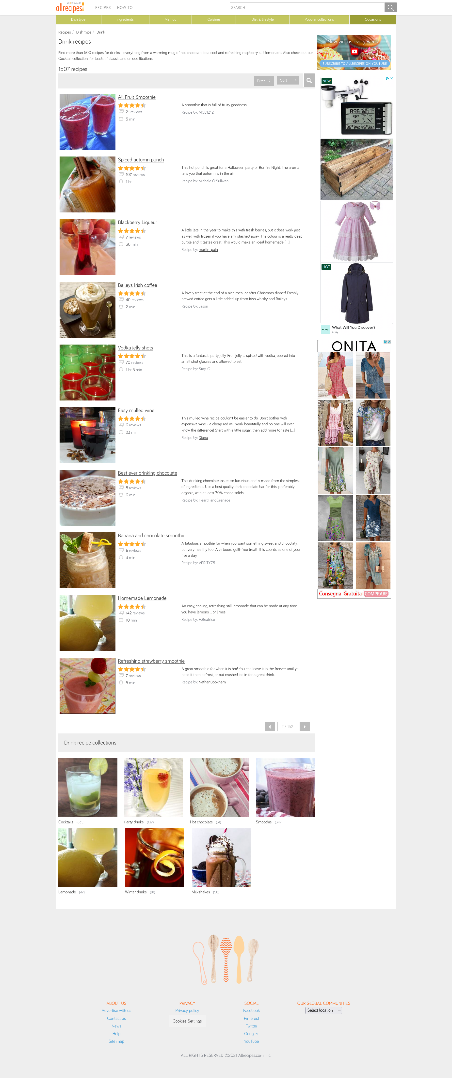

Slide 6
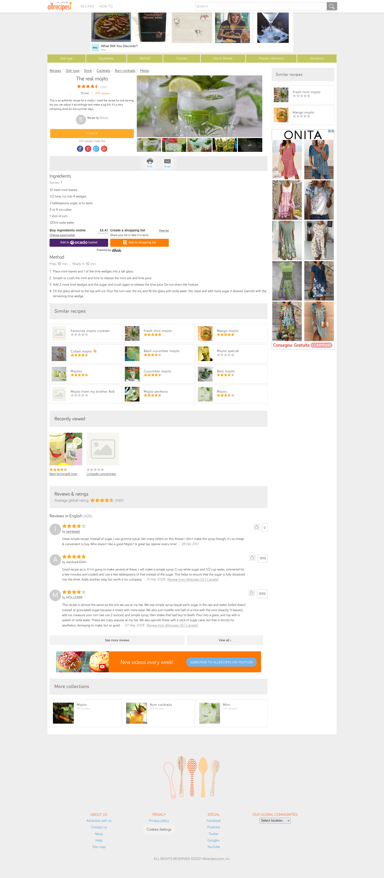

Slide 7





Data Processing & Storage

Slide 8
Data Cleaning
pd.json_normalize()
df.value_counts()
Double check anomalies!
df.duplicated()
df.fillna()

Slide 9
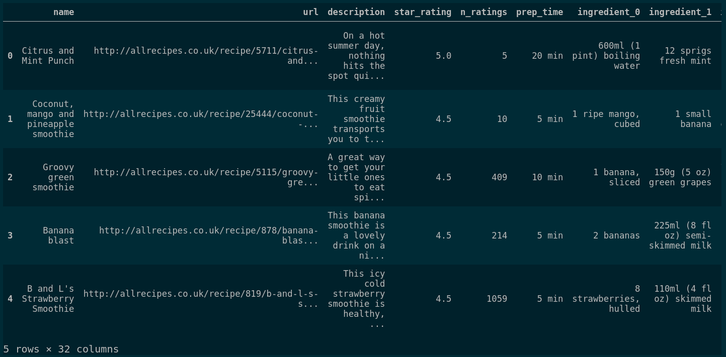

Slide 10
Predictions
Predict name using ingredients.
Categorise drinks using name and description.
Label drinks based on ingredients, description and name.
Predict difficulty based on method.

Slide 11
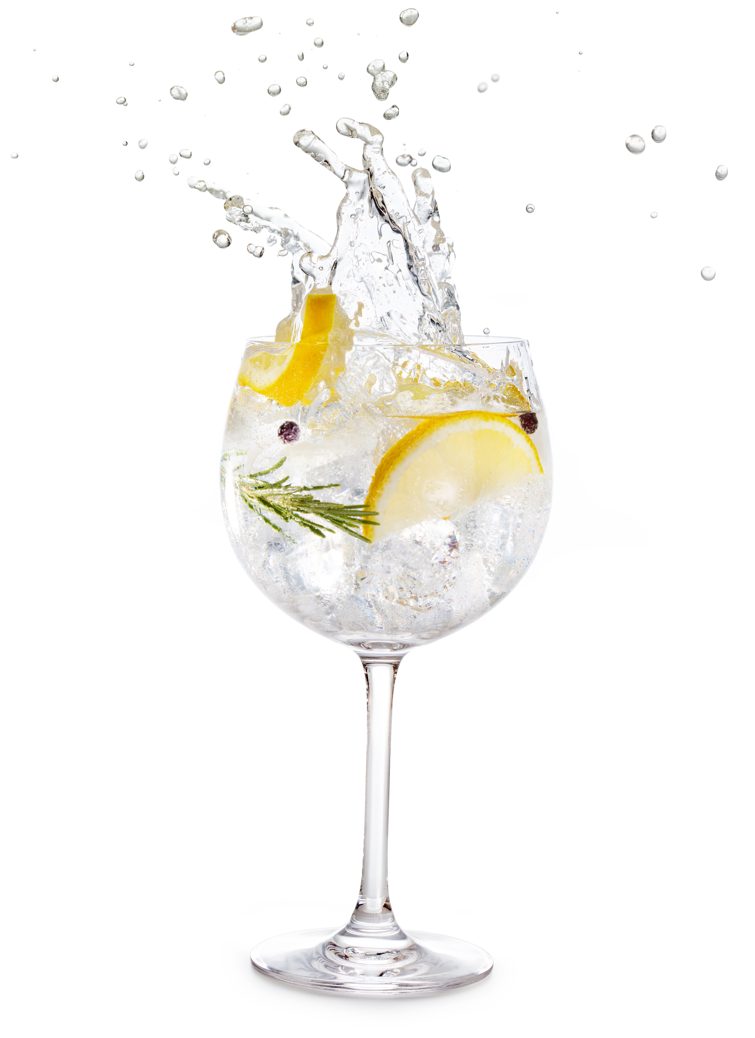
Finally...
Cheers!

